Slide 1


CISC450 Computer Networks
Lesson 3
Data Link Control
Slides courtesy of
William Stallings (mostly)

Slide 2
Flow Control
Ensuring the sending entity does not overwhelm the receiving entity
  Preventing buffer overflow
Transmission time
  Time taken to emit all bits into medium
Propagation time
  Time for a bit to traverse the link

Slide 3
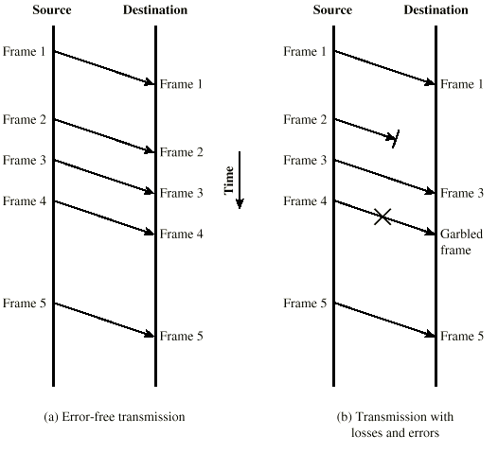
Model of Frame Transmission

Slide 4
Stop and Wait
Source transmits frame
Destination receives frame and replies with acknowledgement
Source waits for ACK before sending next frame
Destination can stop flow by not send ACK
Works well for a few large frames

Slide 5
Stop and Wait
Source transmits single frame
Wait for ACK
If received frame damaged, discard it
  Transmitter has timeout
  If no ACK within timeout, retransmit
If ACK damaged,transmitter will not recognize it
  Transmitter will retransmit
  Receive gets two copies of frame
  Use ACK0 and ACK1

Slide 6
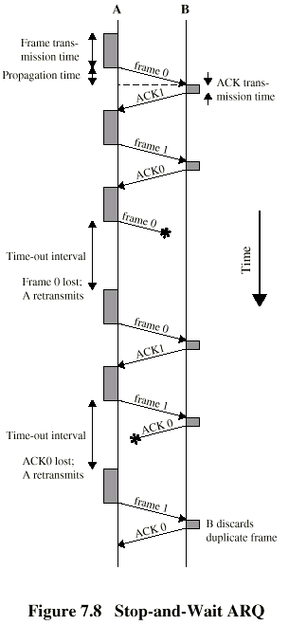
Stop and Wait -
Diagram

Slide 7
Fragmentation
Large block of data may be split into small frames
  Limited buffer size
  Errors detected sooner (when whole frame received)
  On error, retransmission of smaller frames is needed
  Prevents one station occupying medium for long periods
Stop and wait becomes inadequate
  WHY?

Slide 8
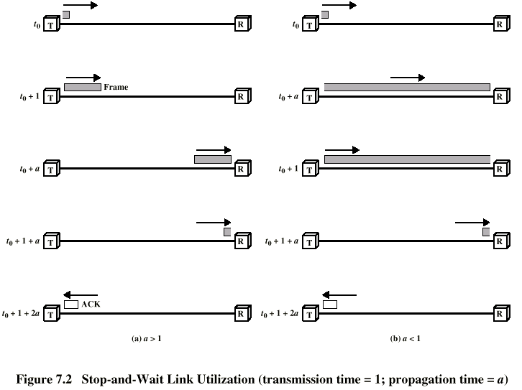
Stop and Wait Link Utilization

Slide 9
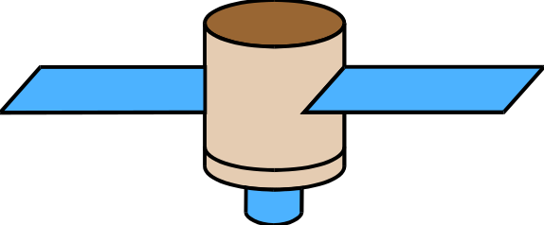


Class Problem
Link speed: 256 Kbps
Frame size: 256 bytes
What is max. link
utilization?
23,000 miles
23,000 miles
1,200 miles

Slide 10
Sliding Windows Flow Control
Allow multiple frames to be in transit
Receiver has buffer W long
Transmitter can send up to W frames without ACK
Each frame is numbered
ACK includes number of next frame expected
Sequence number bounded by size of field (k)
  Frames are numbered modulo 2^{k}

Slide 11
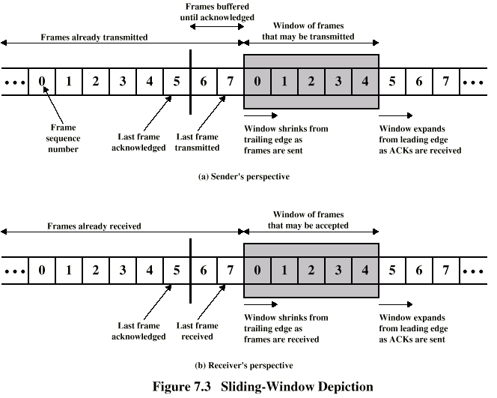
Sliding Window Diagram

Slide 12
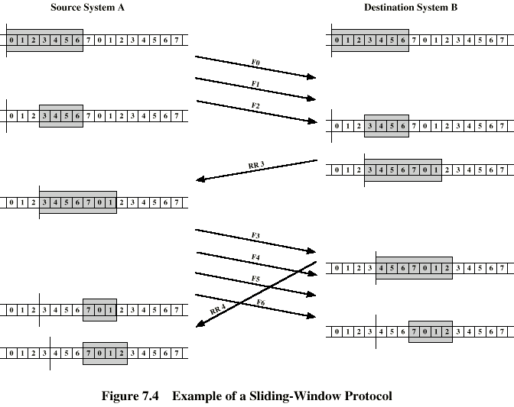
Example Sliding Window

Slide 13
Class Problem
Link speed: 256 Kbps
Frame size: 256 bytes
Window size: 63 frames
What is max. link
utilization?
23,000 miles
23,000 miles
1,200 miles

Slide 14
Sliding Window Enhancements
Receiver can acknowledge frames without permitting further transmission (Receive Not Ready)
Must send a normal acknowledge to resume
If duplex, use piggybacking
  If no data to send, use acknowledgement frame
  If data but no acknowledgement to send, send last acknowledgement number again, or have ACK valid flag (TCP)

Slide 15
Error Detection
Additional bits added by transmitter for error detection code
Parity
  Value of parity bit is such that character has even (even parity) or odd (odd parity) number of ones
  Even number of bit errors goes undetected

Slide 16
Cyclic Redundancy Check
For a block of k bits transmitter generates n bit sequence
Transmit k+n bits which is exactly divisible by some number
Receive divides frame by that number
  If no remainder, assume no error
  For math, see Stallings chapter 7

Slide 17
Error Control
Detection and correction of errors
Lost frames
Damaged frames
Automatic repeat request
  Error detection
  Positive acknowledgment
  Retransmission after timeout
  Negative acknowledgement and retransmission

Slide 18
Automatic Repeat Request (ARQ)
Stop and wait
Go back N
Selective reject (selective retransmission)

Slide 19
Go Back N (1)
Based on sliding window
If no error, ACK as usual with next frame expected
Use window to control number of outstanding frames
If error, reply with rejection
  Discard that frame and all future frames until error frame received correctly
  Transmitter must go back and retransmit that frame and all subsequent frames

Slide 20
Go Back N - Damaged Frame
Receiver detects error in frame i
Receiver sends rejection-i
Transmitter gets rejection-i
Transmitter retransmits frame i and all subsequent

Slide 21
Go Back N - Lost Frame (1)
Frame i lost
Transmitter sends i+1
Receiver gets frame i+1 out of sequence
Receiver send reject i
Transmitter goes back to frame i and retransmits

Slide 22
Go Back N - Lost Frame (2)
Frame i lost and no additional frame sent
Receiver gets nothing and returns neither acknowledgement nor rejection
Transmitter times out and sends acknowledgement frame with P bit set to 1
Receiver interprets this as command which it acknowledges with the number of the next frame it expects (frame i )
Transmitter then retransmits frame i

Slide 23
Go Back N - Damaged Acknowledgement
Receiver gets frame i and send acknowledgement (i+1) which is lost
Acknowledgements are cumulative, so next acknowledgement (i+n) may arrive before transmitter times out on frame i
If transmitter times out, it sends acknowledgement with P bit set as before
This can be repeated a number of times before a reset procedure is initiated

Slide 24
Go Back N - Damaged Rejection
As for lost frame (2)

Slide 25
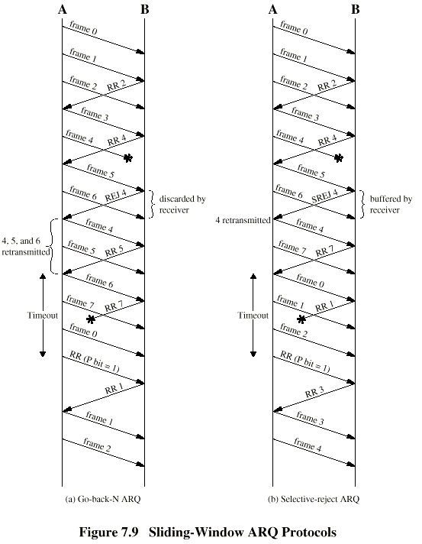
Go Back N -
Diagram

Slide 26
Selective Reject
Also called selective retransmission
Only rejected frames are retransmitted
Subsequent frames are accepted by the receiver and buffered
Minimizes retransmission
Receiver must maintain large enough buffer
More complex login in transmitter

Slide 27
Selective Reject -
Diagram

Slide 28
High Level Data Link Control
HDLC
ISO 33009, ISO 4335
“Daughter of SDLC”
Default inter-router protocol!

Slide 29
HDLC Station Types
Primary station
  Controls operation of link
  Frames issued are called commands
  Maintains separate logical link to each secondary station
Secondary station
  Under control of primary station
  Frames issued called responses
Combined station
  May issue commands and responses

Slide 30
HDLC Link Configurations
Unbalanced
  One primary and one or more secondary stations
  Supports full duplex and half duplex
Balanced
  Two combined stations
  Supports full duplex and half duplex
Has nothing to do with the mental state of the network administrator/programmer. ☺

Slide 31
HDLC Transfer Modes (1)
Normal Response Mode (NRM)
  Unbalanced configuration
  Primary initiates transfer to secondary
  Secondary may only transmit data in response to command from primary
  Used on multi-drop lines
  Host computer as primary
  Terminals as secondary

Slide 32
HDLC Transfer Modes (2)
Asynchronous Balanced Mode (ABM)
  Balanced configuration
  Either station may initiate transmission without receiving permission
  Most widely used
  No polling overhead

Slide 33
HDLC Transfer Modes (3)
Asynchronous Response Mode (ARM)
  Unbalanced configuration
  Secondary may initiate transmission without permission form primary
  Primary responsible for line
  rarely used

Slide 34
Frame Structure
Synchronous transmission
All transmissions in frames
Single frame format for all data and control exchanges

Slide 35
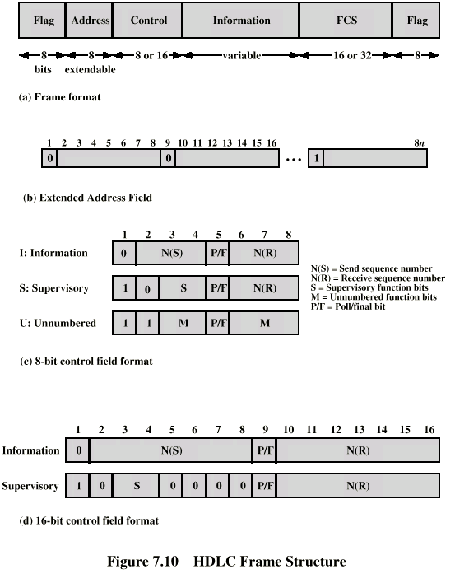
Frame Structure Diagram

Slide 36
Flag Fields
DATA TRANSPARENCY
WHY IS IT IMPORTANT?
Delimit frame at both ends
01111110
May close one frame and open another
Receiver hunts for flag sequence to synchronize
Bit stuffing used to avoid confusion with data containing 01111110
  0 inserted after every sequence of five 1s
  If receiver detects five 1s it checks next bit
  If 0, it is deleted
  If 1 and seventh bit is 0, accept as flag
  If sixth and seventh bits 1, sender is indicating abort

Slide 37
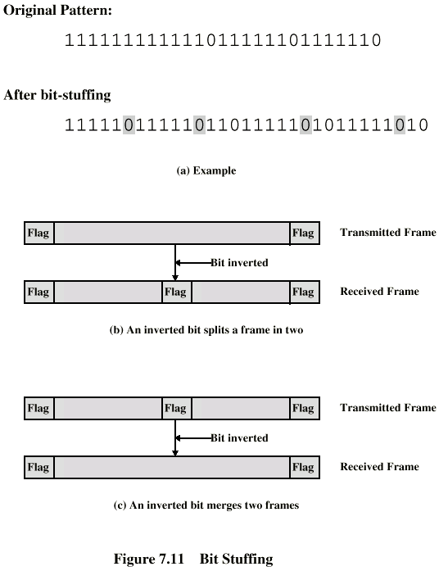
Bit Stuffing
Example with
possible errors

Slide 38
Address Field
Identifies secondary station that sent or will receive frame
Usually 8 bits long
May be extended to multiples of 7 bits
  LSB of each octet indicates that it is the last octet (1) or not (0)
All ones (11111111) is broadcast

Slide 39
Control Field
Different for different frame type
  Information - data to be transmitted to user (next layer up)
    Flow and error control piggybacked on information frames
  Supervisory - ARQ when piggyback not used
  Unnumbered - supplementary link control
First one or two bits of control filed identify frame type
Remaining bits explained later

Slide 40
Control Field Diagram

Slide 41
Poll/Final Bit
Use depends on context
Command frame
  P bit
  1 to solicit (poll) response from peer
Response frame
  F bit
  1 indicates response to soliciting command

Slide 42
Information Field
Only in information and some unnumbered frames
Must contain integral number of octets
Variable length

Slide 43
Frame Check Sequence Field
AKA, FCS
Error detection
16 bit CRC
Optional 32 bit CRC

Slide 44
HDLC Operation
Exchange of information, supervisory and unnumbered frames
Three phases
  Initialization
  Data transfer
  Disconnect

Slide 45
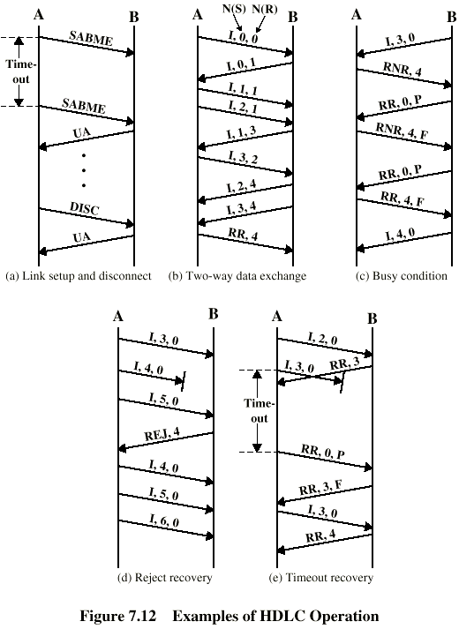
Examples of Operation (1)

Slide 46
Examples of Operation (2)

Slide 47
Other DLC Protocols (LAPB,LAPD)
Link Access Procedure, Balanced (LAPB)
  Part of X.25 (ITU-T)
  Subset of HDLC - ABM
  Point to point link between system and packet switching network node
Link Access Procedure, D-Channel
  ISDN (ITU-D)
  ABM
  Always 7-bit sequence numbers (no 3-bit)
  16 bit address field contains two sub-addresses
    One for device and one for user (next layer up)

Slide 48
Other DLC Protocols (LLC)
Logical Link Control (LLC)
  IEEE 802
  Different frame format
  Link control split between medium access layer (MAC) and LLC (on top of MAC)
  No primary and secondary - all stations are peers
  Two addresses needed
    Sender and receiver
  Error detection at MAC layer
    32 bit CRC
  Destination and source access points (DSAP, SSAP)

Slide 49
Other DLC Protocols
(Frame Relay) (1)
Streamlined capability over high speed packet witched networks
Used in place of X.25
Uses Link Access Procedure for Frame-Mode Bearer Services (LAPF)
Two protocols
  Control - similar to HDLC
  Core - subset of control

Slide 50
Other DLC Protocols
(Frame Relay) (2)
ABM
7-bit sequence numbers
16 bit CRC
2, 3 or 4 octet address field
  Data link connection identifier (DLCI)
  Identifies logical connection
More on frame relay later

Slide 51
Other DLC Protocols (ATM)
Asynchronous Transfer Mode
Streamlined capability across high speed networks
Not HDLC based
Frame format called “cell”
Fixed 53 octet (424 bit)
Details later

